Slide 1

ATM system A secure and user-friendly ATM simulation project.

Slide 2

AGENDA
INTRODUCTION
Problem Statement and Solution
Features
Development Process
Technical Details
Demonstration
Lessons Learned
Future Improvements
Conclusion

Slide 3
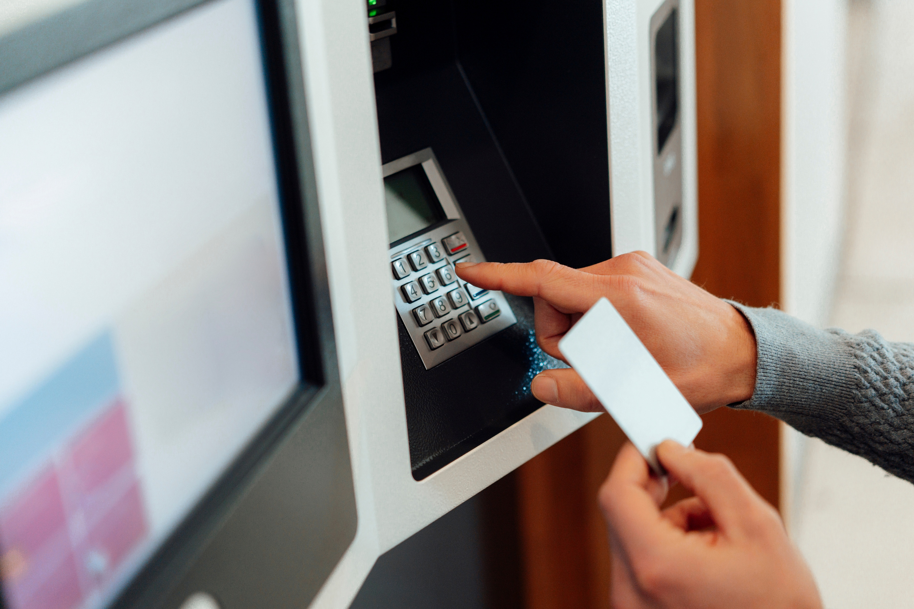
Introduction to ATM system
Automated Teller Machines (ATMs) are crucial for modern banking, providing convenience and accessibility to cash. This presentation will explore the evolution, benefits, and challenges of ATM systems, emphasizing their role in enhancing financial accessibility for diverse populations.

Slide 4
Problem Statement and Solution
Problem:
"Banking systems need secure, accessible, and efficient methods for cash withdrawals, deposits, and account inquiries. Simulating an ATM system helps address these requirements and teaches robust software development practices."
Solution:
"Our ATM System provides a secure and intuitive interface for users to perform transactions like withdrawals, deposits, and balance inquiries, ensuring data security and accuracy."

Slide 5




Features
Secure login with PIN.
Account balance inquiry.
Cash withdrawal and deposit.
Transaction history display.

Slide 6
Development Process
Week 1: Requirement Gathering
- Researched ATM Functionalities.
- Define Project Scope.
Week 2: Authentication and Backend logic
- Created User Authentication (Pin System).
- Added Basic Functionality (Withdraw, Deposit).
Week 4: Testing and Debugging
- Tested Edge Cases
(e.g. ,Incorrect Pin).
- Finalized The Project.
Week 3: Database Integration
- Integrated SQLite to Store User Accounts and Transaction.

Slide 7
Technical Details
Programming Language: C++ for backend logic.
User Interface: command line interface (CLI).
Development Environment: Dev C++ (IDE for C++ development on Windows).

Slide 8
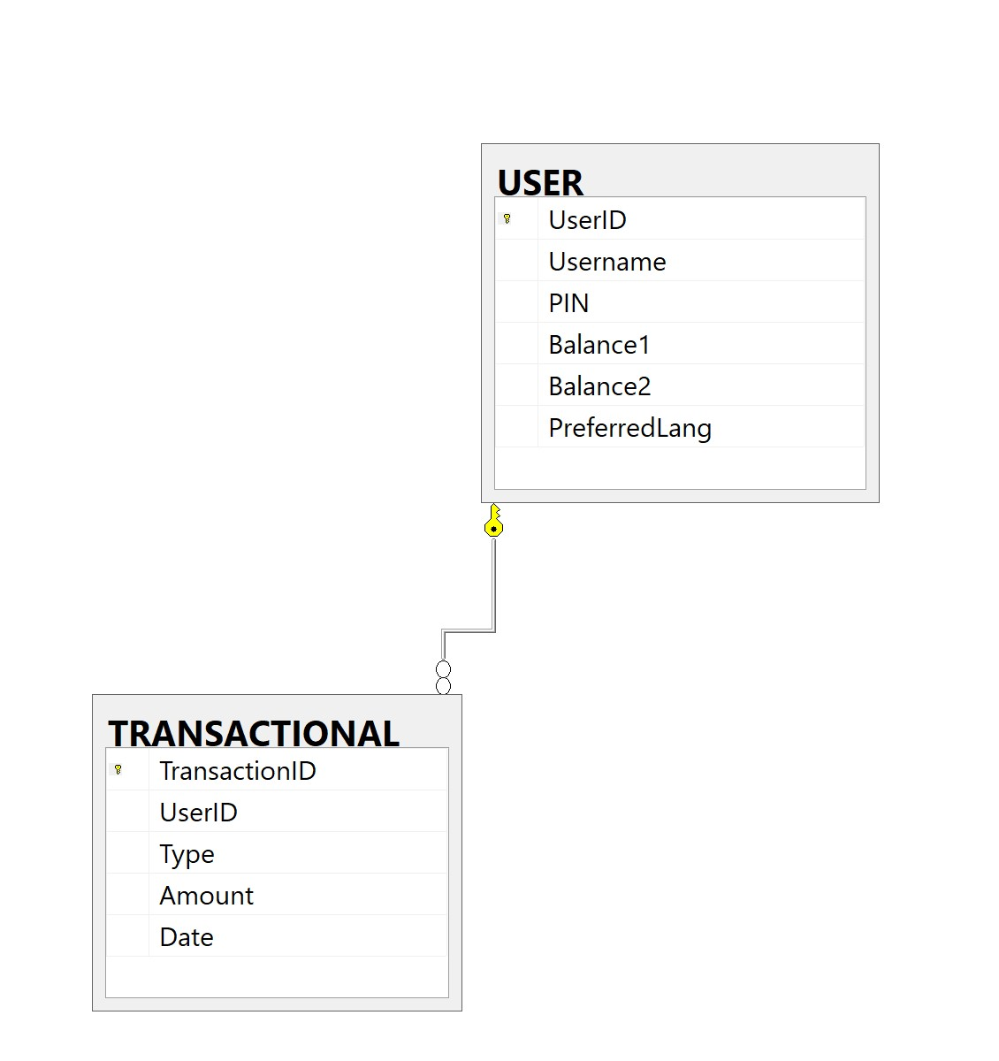
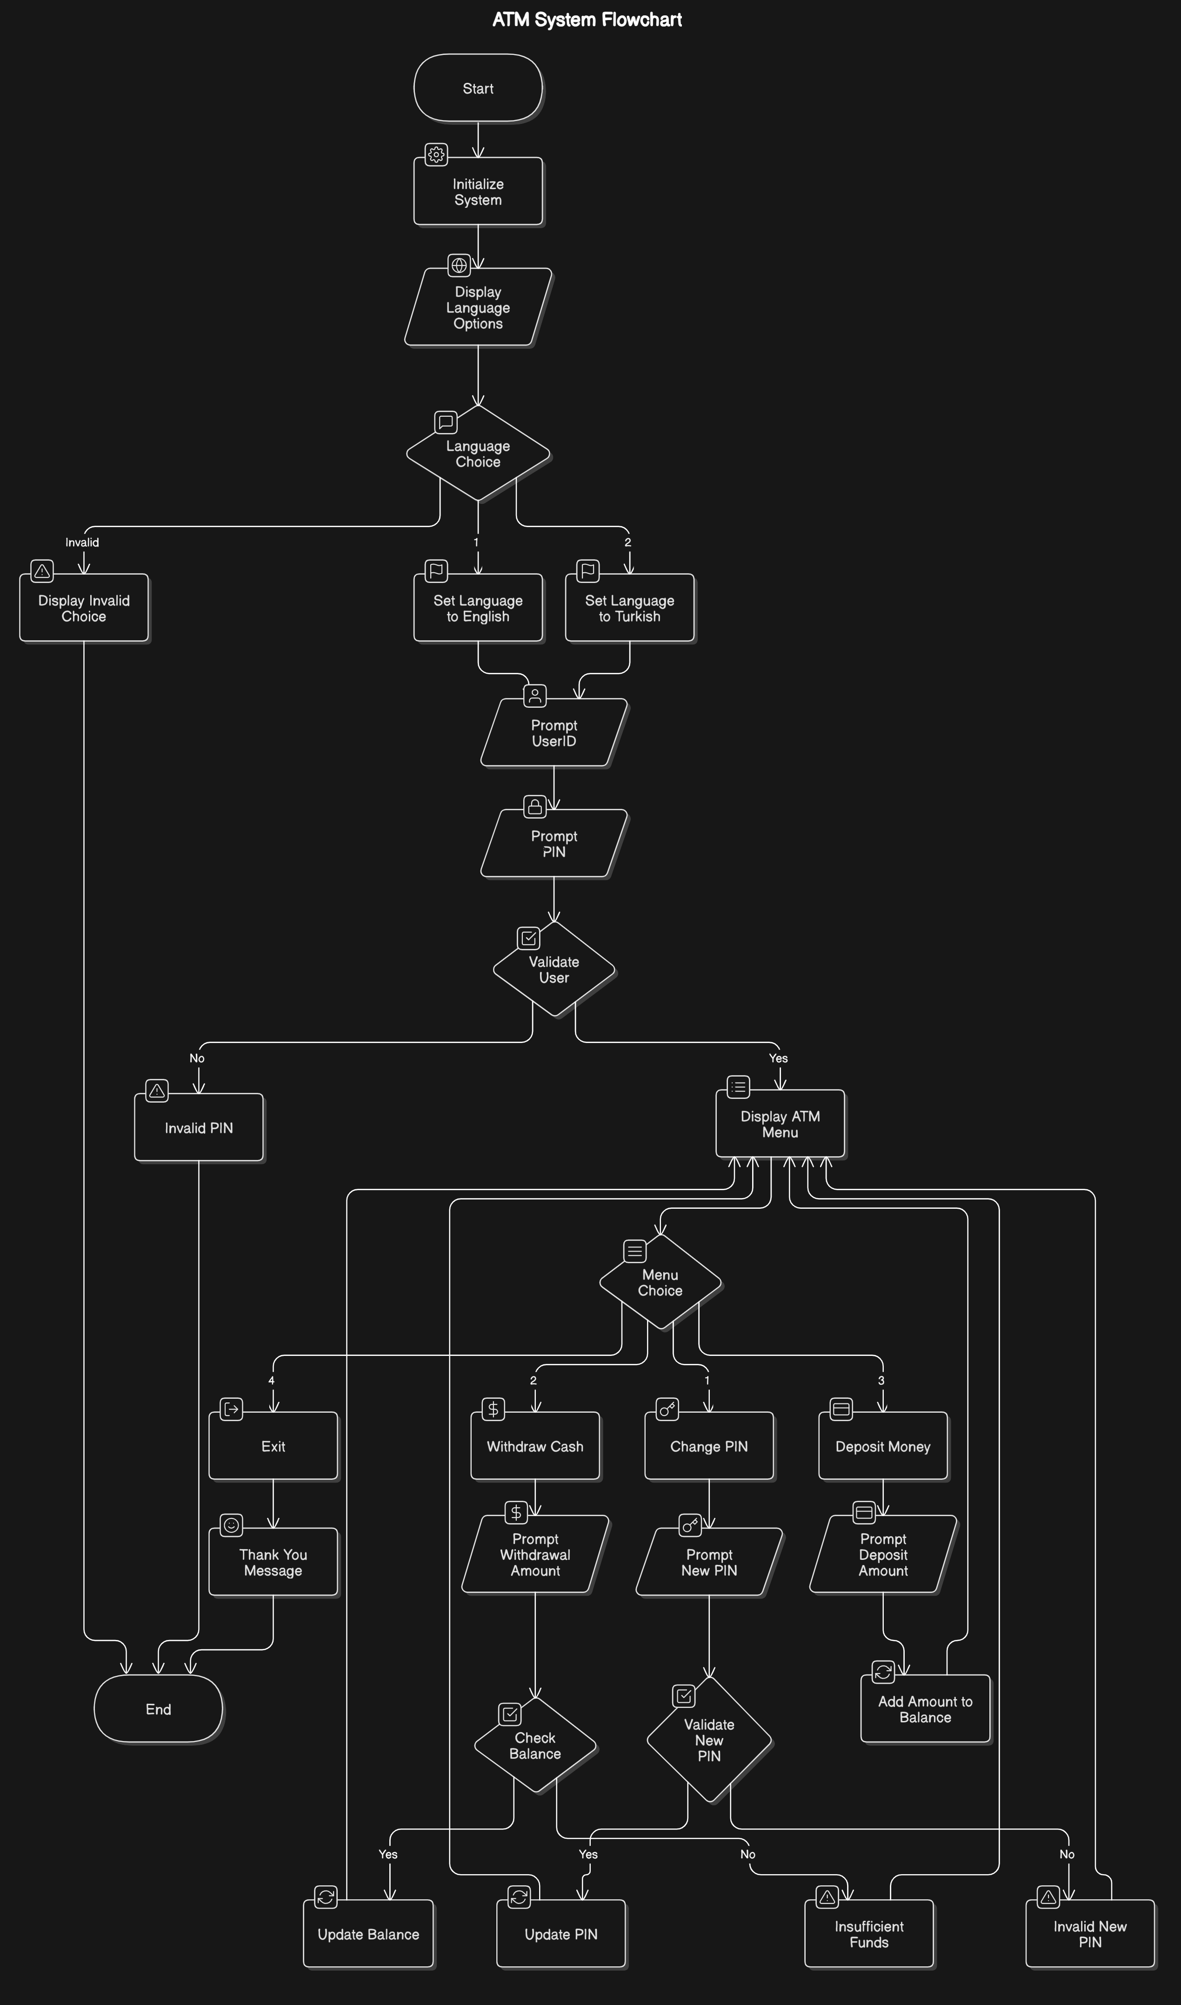
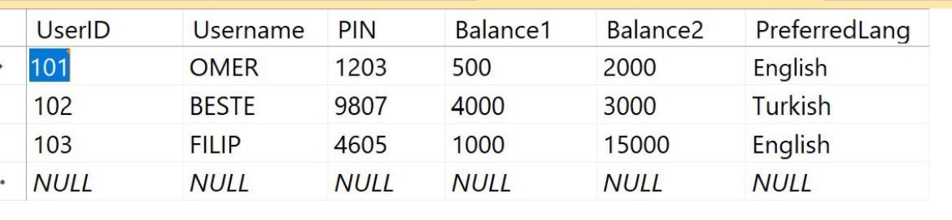
Technical Details
SQLite for the database.
Architecture (Flowchart)

Slide 9
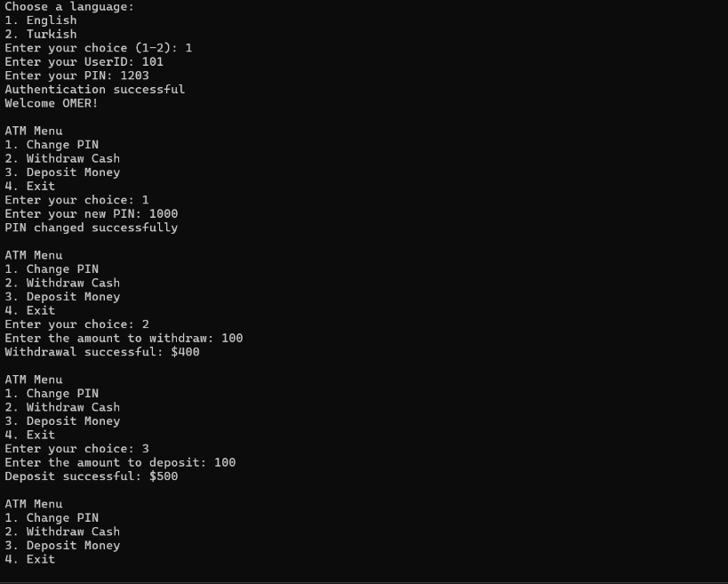
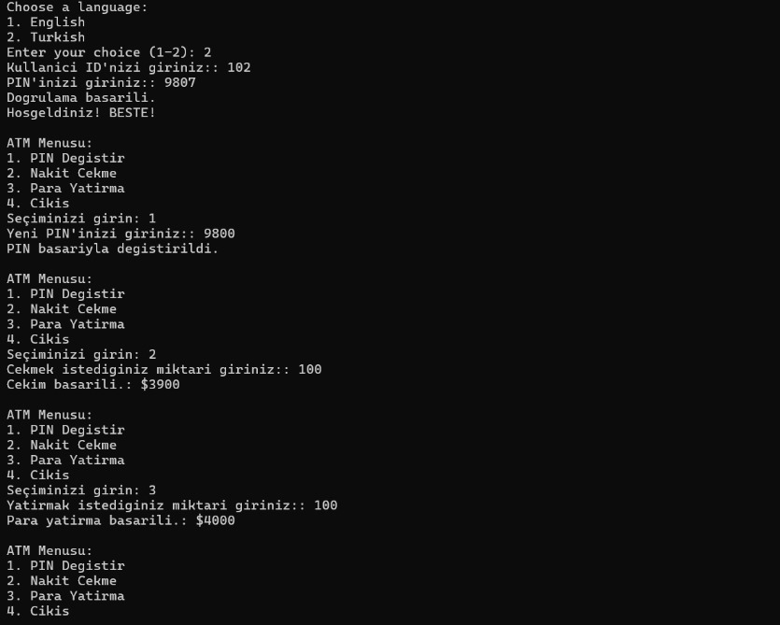
Demonstration

Slide 10
Lessons Learned
User-Centric Design: Stakeholder feedback shaped user stories and system features.
Organized Development: Breaking down tasks into manageable components streamlined implementation.
Thorough Testing: Rigorous testing identified bugs early, ensuring system reliability.
Agile Practices: Iterative development improved adaptability and helped meet deadlines.
Documentation: Comprehensive README and manuals enhanced accessibility and usability.

Slide 11
Future Improvements
Adding biometric authentication.
Integrating with bank APIs for real-time transactions.
Mobile app support.

Slide 12
Conclusion
The ATM System is a robust and secure simulation of an automated teller machine, designed to provide real-world functionality and learning opportunities in software development.

Slide 13

THANK YOU

